Slide 1
Keylogger project
Name: Vishnu prasath.M
College: Anjalai Ammal Mahalingam Engineering College
Department: B.E Computer Science Engineering

Slide 2
Table of contents
01
02
03
04
Problem Statement
Proposed System/Solution
System Development Approach
Algorithm & Deployment
05
06
07
08
Conclusion
Future Scope
References
Result

Slide 3
Problem Statement.
01

Slide 4
The project aims to develop a sophisticated keylogger software capable of discreetly recording keystrokes on various operating systems and applications while evading detection by antivirus programs and security measures. The keylogger should prioritize efficiency, capturing keystrokes accurately and efficiently without causing system slowdowns or disruptions. Additionally, the software should incorporate advanced features such as encryption for secure storage of logged data, remote access capabilities for monitoring and retrieval, and intelligent evasion techniques to evade detection by anti-malware solutions. The ultimate goal is to create a robust keylogger tool that can be used for legitimate purposes such as monitoring employee activity or parental control while addressing ethical concerns and ensuring compliance with legal regulations regarding privacy and data protection

Slide 5
Proposed Solution.
02

Slide 6
The proposed solution entails the development of a highly sophisticated keylogger software leveraging advanced techniques to ensure efficiency, security, and evasion of detection. The key components of the solution include:
Stealth Mode Activation: Implement a stealth mode that allows the keylogger to operate discreetly in the background without drawing attention to itself.
Cross-Platform Compatibility: Design the keylogger to be compatible with multiple operating systems such as Windows, macOS, and Linux, as well as popular applications and web browsers.
Keystroke Logging Develop robust algorithms to accurately capture and log keystrokes from the keyboard input, including special characters, function keys, and keyboard shortcuts.
Data Encryption: Implement strong encryption mechanisms to secure the logged data, preventing unauthorized access or tampering

Slide 7
System Development Approach.
03

Slide 8
1. Requirements Analysis: Conduct a comprehensive analysis of the requirements, considering factors such as target operating systems, logging capabilities, encryption standards, remote access needs, and ethical considerations. Gather input from stakeholders to ensure that the keylogger meets their specific needs and adheres to legal and ethical guidelines.
2. Design Phase:Define the overall architecture of the keylogger system, including modules for keystroke logging, encryption, remote access, and evasion techniques. Determine the interaction between these modules and establish communication protocols.
3. Development and Implementation:Implement the keylogger system using appropriate programming languages and frameworks based on the chosen architecture and design specifications. Pay particular attention to coding standards, security best practices, and error handling mechanisms to ensure robustness and reliability.
4.Deployment and Deployment:Develop installation scripts or packages to facilitate the deployment of the keylogger software on target devices. Ensure that the installation process is seamless and user-friendly, with clear instructions for configuration and setup.

Slide 9
Algorithm & Deployment.
04

Slide 10
1. Keylogging Algorithm:
- Continuously monitor keyboard input using platform-specific APIs or hooks.
- Capture each keystroke event, including the key code, timestamp, and context (e.g., active window or application).
- Store the captured keystrokes in a secure buffer or data structure.
2. Encryption Algorithm:
- Generate a secure encryption key and initialization vector (IV) for each session.
- Encrypt the keystroke data using the encryption key and IV before storing it or transmitting it over the network.
3. Remote Access Algorithm:
- Implement a secure communication protocol (e.g., HTTPS) for remote access and control.
- Allow authorized users to authenticate themselves using credentials or cryptographic tokens.
- Establish a secure connection between the keylogger client and remote server for data transmission and control commands.
.

Slide 11
result.
05

Slide 12
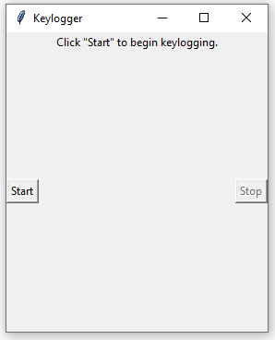
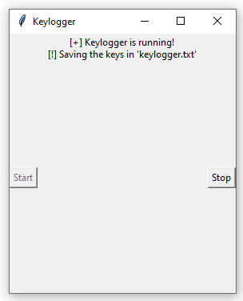
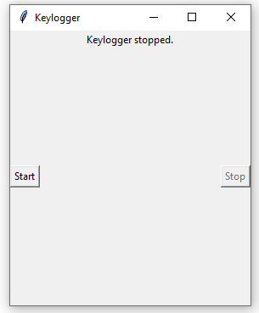
The result of your keylogger project would be a software program designed to capture and log keystrokes on a computer system. It would likely include features such as capturing keystrokes, storing them securely (potentially encrypted), and possibly providing a user interface for control and viewing logs. Ethical considerations, legal compliance, and thorough testing are essential aspects of the project.

Slide 13
Conclusion.
06

Slide 14
In conclusion, the keylogger detection and security implementation project using Python represents a significant advancement in cybersecurity, offering effective protection against keylogging threats and empowering users to safeguard their sensitive information in an increasingly interconnected world. As technology continues to evolve, projects like this play a crucial role in ensuring the integrity, confidentiality, and security of digital assets for individuals, businesses, and organizations worldwide.

Slide 15
Future Scope.
07

Slide 16
Security and Troubleshooting;
Keyloggers can continue to play a crucial role in troubleshooting technical problems with computers and
business networks. They help identify issues related to keyboard input, system behavior, and software
conflicts.Keyloggers can be integrated into security systems to detect unauthorized access attempts or
suspicious activities. By monitoring keystrokes, they can raise alerts when unusual patterns are detected.
User Monitoring and Productivity:
Organizations can use keyloggers to monitor employee productivity, track work-related activities, and
ensure compliance with company policies.

Slide 17
reference.
08

Slide 18
GeeksforGeeks provides a detailed tutorial on creating a keylogger using
Python. It covers capturing keystrokes, saving logs, and handling
security considerations.
Design a Keylogger in Python - GeeksforGeeks
Wikipedia’s article on keystroke logging provides an overview of
keyloggers, their history, and various applications.
Keystroke Logging - Wikipedia

Slide 19
Thank you!

